Slide 1

Mini Project-I (K24MCA18P) Odd Semester Session 2024-25
“Airline Reservation System”
Team Leader- Gulshan Kumari Roll No- 2426MCA1937
Member 1- Himanshi Sharma Roll No-2426MCA206
Member 2- Mukul Dhiman Roll no- 2426MCA888
Project Supervisor:
Prof. Arpit Sir
Assistant Professor

Slide 2
Content
Introduction (1 slide)
Literature Review (2 slides)
Objective of the Project (1 slide)
Technology
Hardware Requirements (Development Environment, Server requirement (if required), Client requirement (if required).
Software Requirements (Language and Platforms like Frameworks, VS code, Android Studio and Jupyter notebook etc. )
Modules (2-3 slides)
Workflow (1 slide)
Reports (For Example: Project : Student Monitoring System, so reports like: Student Marks, Subjects, companies visit, and student appears in placement etc.)
References (1 slide)

Slide 3

Introduction
Flight Booking Systems are essential for managing airline reservations. This presentation will explore how web development techniques can optimize these systems, enhancing user experience and operational efficiency. We will cover the latest trends and best practices in the industry.
A Flight Booking Web Application allows users to search for available flights, book tickets, and manage reservations online. It can handle essential operations such as flight search, booking, payment processing, and issuing electronic tickets (e-tickets).
These systems handle everything from flight schedules and seat availability to ticket issuance and passenger data management

Slide 4

Literature Review
Airline reservation systems (ARS) are a core part of modern air travel, responsible for managing flight bookings, cancellations, check-ins, and passenger data. These systems have evolved from manual booking methods to highly automated, real-time systems capable of handling millions of transactions daily. The development of ARS has significantly impacted the airline industry, improving efficiency, customer satisfaction, and business intelligence.
This literature review explores the key developments, challenges, and trends in airline reservation systems, analyzing existing works and research to understand how these systems have shaped the airline industry

Slide 5
Technology (Hardware Requirements)
Hardware Requirement:
- Processor: Minimum Intel i5 or equivalent.
- RAM: At least 8GB (16GB recommended for smoother multitasking).
- Storage: Minimum 250GB SSD for faster performance.
- Operating System: Windows 10, macOS, or Linux (Ubuntu preferred for development).
- A Server (if required for deployment, otherwise localhost server like Apache Tomcat)

Slide 6
Objective of the Project
Streamlining the flight booking process by allowing users to search, select, and reserve flights based on their preferences.
Providing secure and seamless payment processing for flight bookings.
Enabling flight management for administrators to handle flight schedules, seat availability, pricing, and reporting.
Offering real-time flight status updates and notifications to users.
Improving user experience with features like online check-in, seat selection, and easy booking modifications or cancellations.
Ensuring system security and safeguarding user data throughout the booking process.

Slide 7
Technology (Software Requirements)
Frontend Development:
HTML
CSS
JavaScript
( For structuring and designing the user interface).
Backend Development:
Java Servlet, JSP
MySQL
(For relational databases (e.g., handling user data)

Slide 8
Modules
1. User Management Module
Purpose: Manage users (customers, admins) who interact with the system.
Features:
User registration and login.
Profile management (update contact details, preferences).
Password reset and account recovery.
Role-based access control (admin, customer, travel agent).

Slide 9
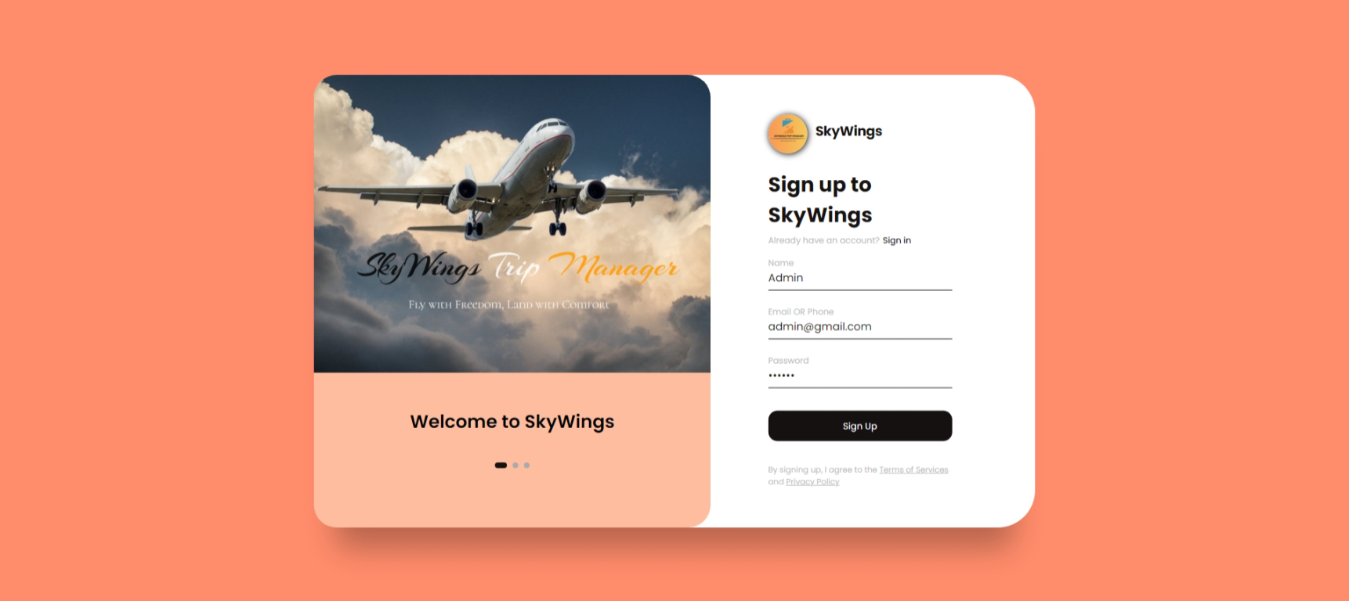
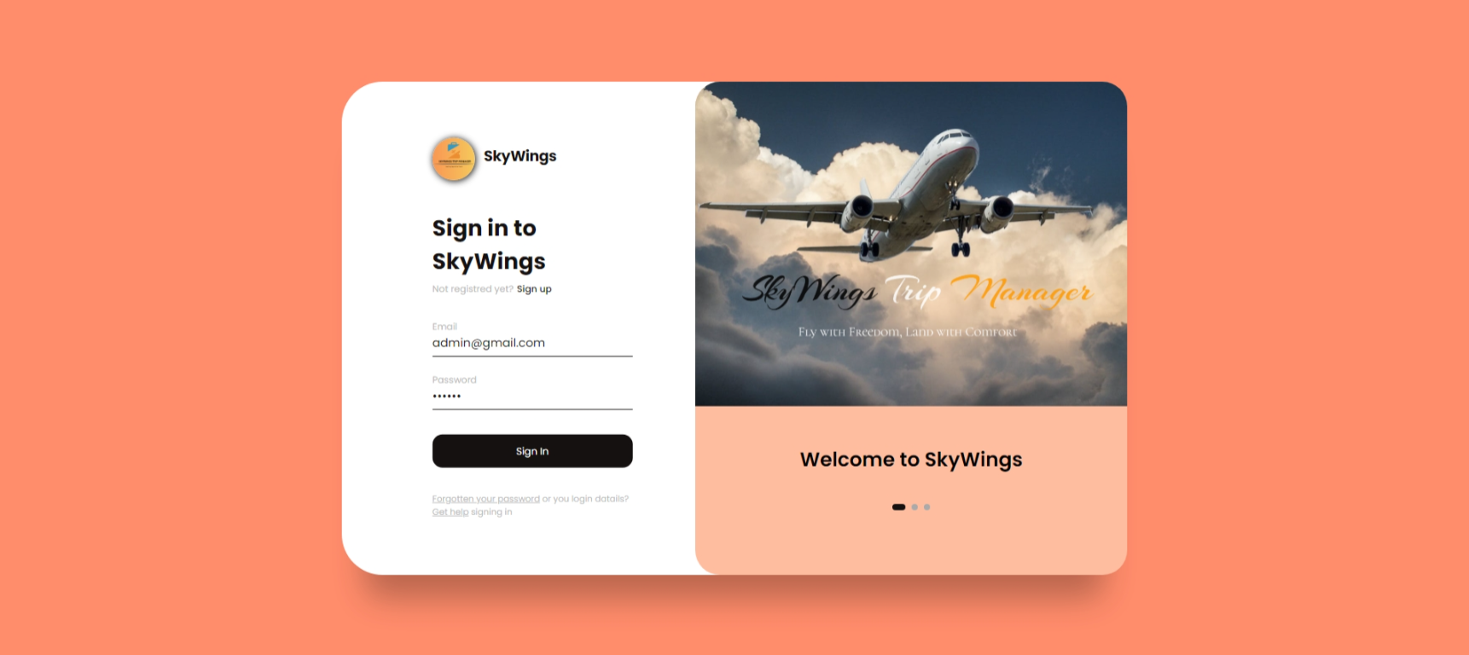
CUSTOMER SIGN UP PAGE:
CUSTOMER LOGIN IN PAGE :

Slide 10
Modules (Contd.)
2. Flight Search Module
Purpose: Allow users to search for available flights based on specific criteria.
Features:
Search flights by departure and destination locations.
Filter by date, time, airline, and flight type (direct, connecting).
Display available seats and pricing for selected flights.
Sorting options (e.g., by price, duration, departure time).

Slide 11
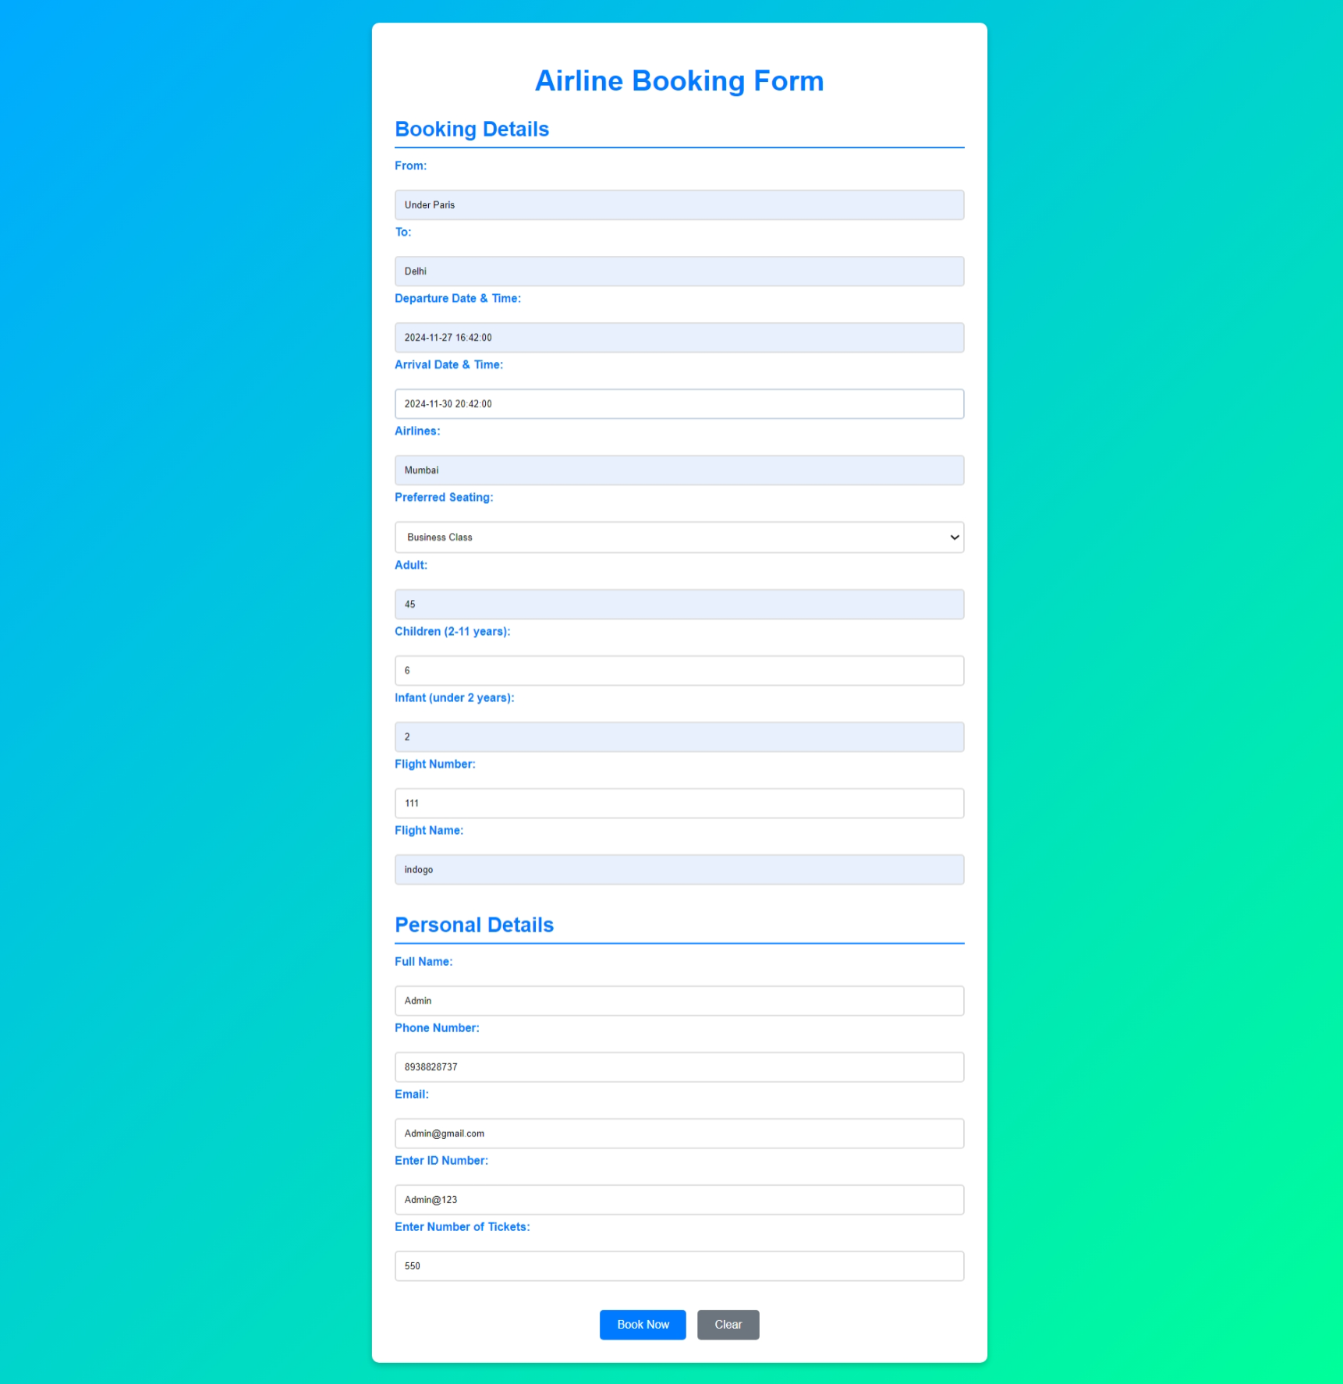
Modules (Contd.)
3. Flight Booking Module
Purpose: Enable users to book flights and reserve
seats.
Features:
Select flight and seat preferences (e.g., window, aisle).
Input passenger details (name, age, passport information).
Real-time seat availability updates.
Booking confirmation (email and SMS).
Notes:
Font Styles: Times New Roman + Font Size: 25

Slide 12
Modules (Contd.)
4. Flight Management Module (Admin)
Purpose: Administer flight details and manage airline operations.
Features:
Add, update, or delete flight schedules.
Manage seat inventory and ticket pricing.
Monitor booking trends and flight occupancy.
Dynamic pricing adjustments based on demand.
Notes:
Font Styles: Times New Roman + Font Size: 25

Slide 13
Modules (Contd.)
5. Ticket Management Module
Purpose: Generate and manage flight tickets for users.
Features:
Generate electronic tickets (e-tickets).
View and print ticket details.
Modify or cancel bookings.
Issue refunds or credits for cancellations.
Notes:
Font Styles: Times New Roman + Font Size: 25

Slide 14
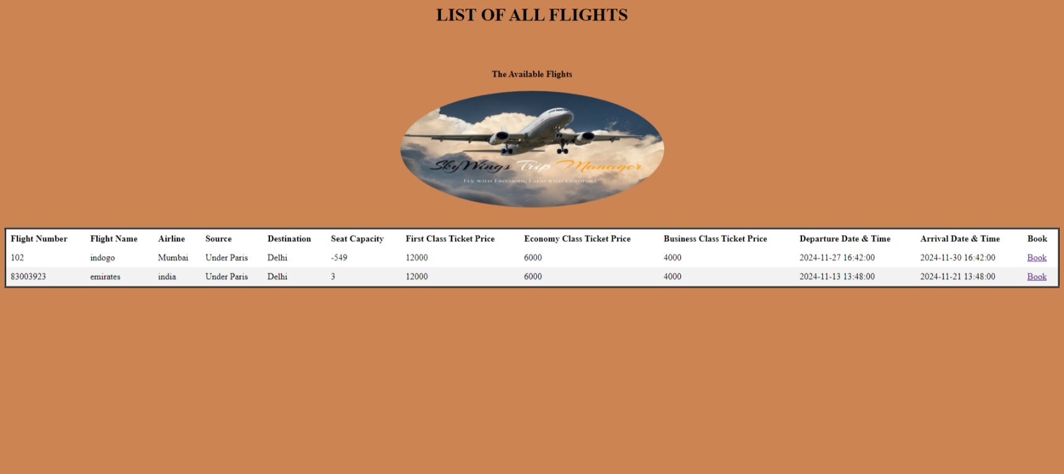
Modules (Contd.)
6. Flight Status & Notifications Module
Purpose: Keep passengers updated on the status of their flights
.
Features:
Real-time flight status updates (on-time, delayed, canceled).
Notification alerts via email or SMS.
Weather-related updates or emergency alerts
Notes:
Font Styles: Times New Roman + Font Size: 25

Slide 15
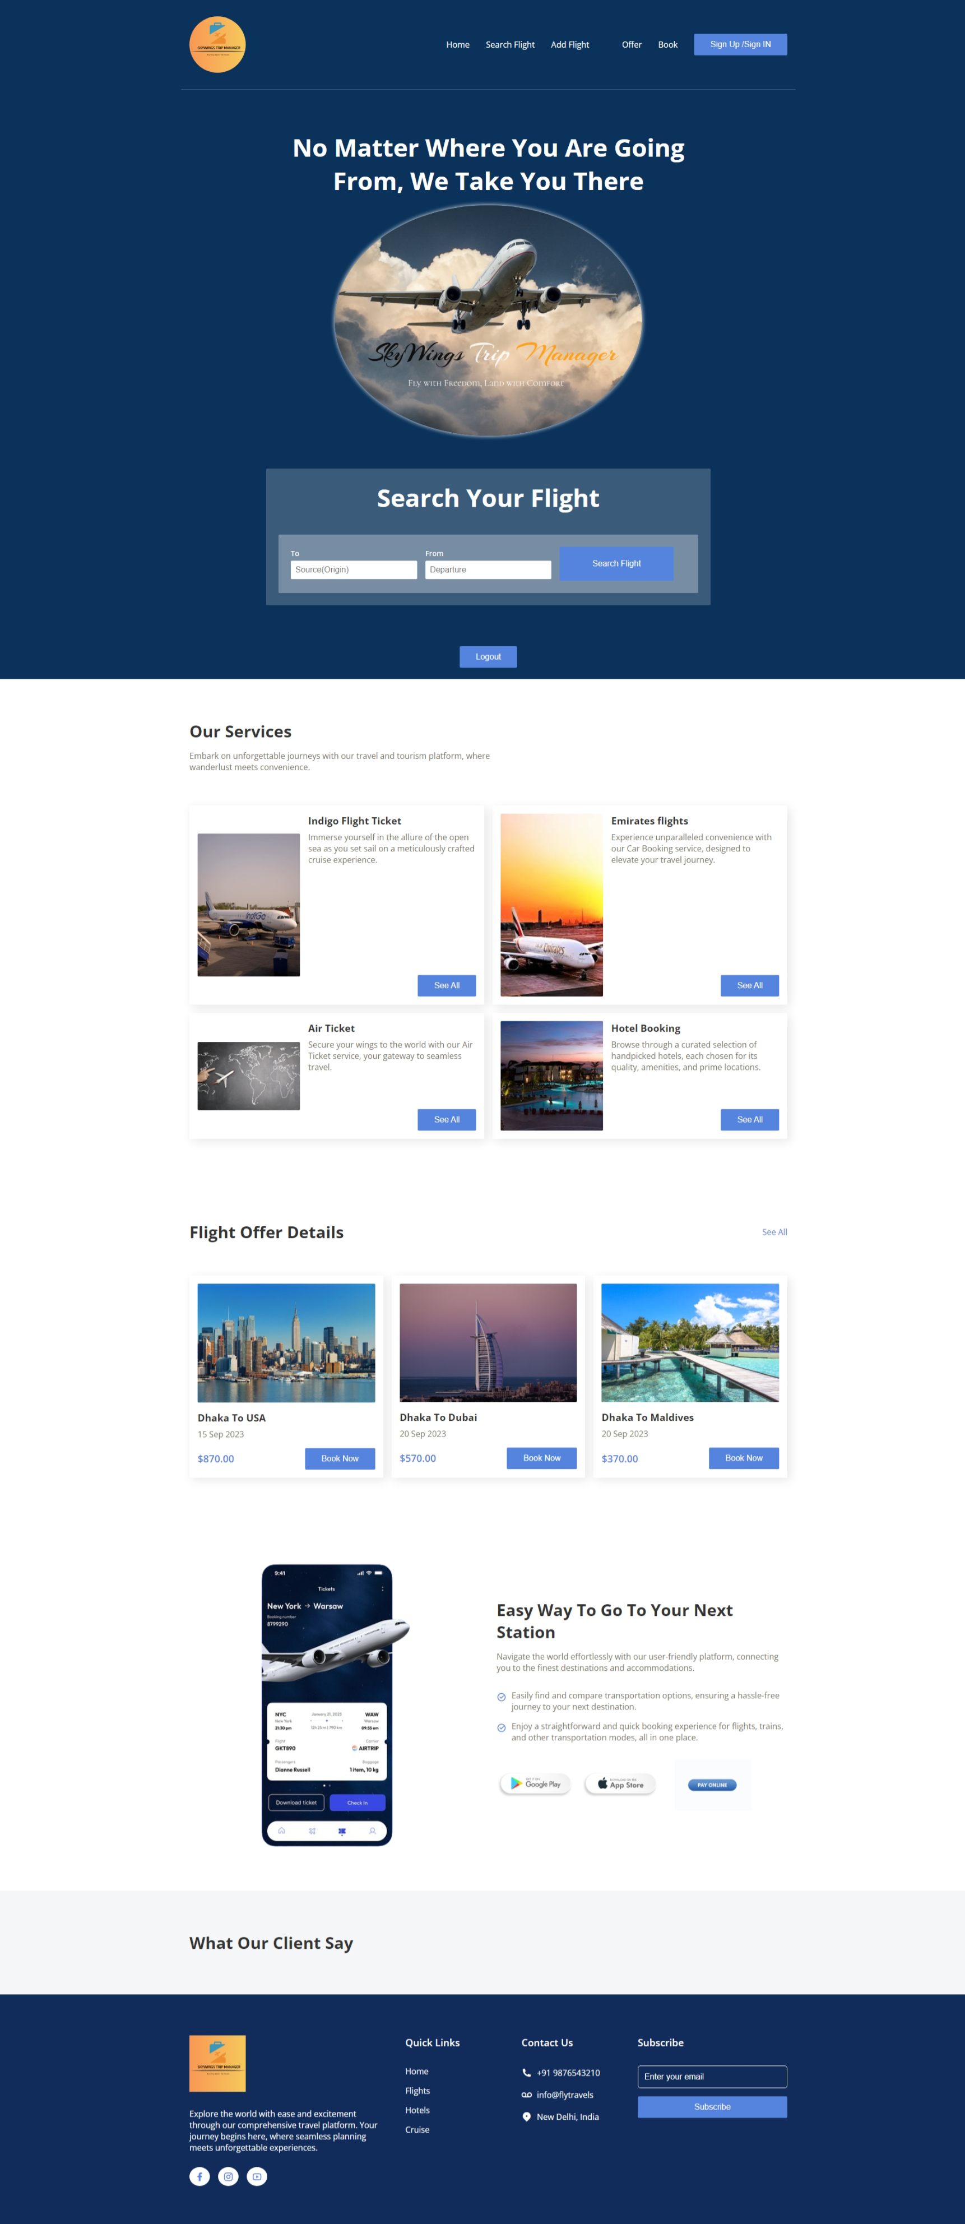
Workflow/Gantt Chart
1.Start(Home Page)
The entry point for both new and returing users.
2.User Registration and Login
Users register or log in to access their accounts and manage bookings.
3.Search for Flights
Users search for available flights based on criteria like location and date.
4.Flight Selection and Seat Reservation
Users select flights and reserve seats based on availability.
5.Payment Processing
Users proceed with payment through the available payment gateways.
Notes:
Font Styles: Times New Roman + Font Size: 25

Slide 16
Workflow/Gantt Chart
6.Ticket Management and Booking Confirmation
Users receive e-tickets and booking confirmation.
7.Check-In (Optional)
Users check in online and download boarding passes before the flight.
8.Flight Status and Notifications
Users receive real-time updates about flight status via email or SMS.
9.Booking Cancellation or Modification
Users can modify or cancel bookings and receive refunds if applicable.
10.End(System Logout)
After all operation are completed ,users can log out.
Notes:
Font Styles: Times New Roman + Font Size: 25

Slide 17
Reports
1. User Booking Report
Lists all bookings made by users, including flight details, dates, and booking status (confirmed, canceled).
2. Payment Report
Provides a summary of all payments made, including payment methods, amounts, and transaction statuses.
3. Flight Availability Report
Displays current seat availability for upcoming flights, helping admins manage inventory.
4. Cancellation and Refund Report
Details the number of cancellations, reasons for cancellations, and refunds processed.
5. Customer Support Report
Tracks user queries, complaints, and resolutions, helping to improve customer service.
Notes:
Font Styles: Times New Roman + Font Size: 25

Slide 18
References
HTML,CSS,JS – MDN website
MySQL -- Retrieved from https://dev.mysql.com/doc/
GitHub Documentation : GitHub – Retrieved from https://docs.github.com/
Java Server Pages – Retrived from https://www.geeksforgeeks.org/
Java Servlet– Retrived from https://www.geeksforgeeks.org/
Notes:
Font Styles: Times New Roman + Font Size: 25

Slide 19
Conclusion :
The airline reservation system simplifies and automates the process of booking, managing, and tracking flights. It ensures efficient scheduling, real-time seat availability, and streamlined customer interactions, enhancing user experience and operational efficiency for airlines and passengers

Slide 20
Thank You

